Slide 1
Flight Delays & Cancellations Analysis
Presented by:
Kefan Liao, Michael Gattone, Fay Muhammad, and Chris Scarlata
Source: Bureau of Transportation Statistics – US Dept. of Transportation
Kaggle Flights Analysis

Slide 2

Hypothesis Statement
The COVID-19 pandemic significantly contributed to an increase in domestic flight delays and cancellations in 2020.
It is hypothesized that the widespread global health crisis led to:
Government-imposed travel restrictions
Decreased passenger demand
Operational challenges within the aviation industry
Collectively resulting in a substantial disruption to domestic air travel during the specified period.

Slide 3
Questions to Consider
Which airline(s) dominated the U.S. domestic flight market? Why? – Chris
What are the trends in domestic flight cancellations? What events contributed to spikes in flight cancellations? – Mike
Did the pandemic impact the frequency or duration of flight delays? – Kefan
Which airlines experienced frequent delays and cancellations? – Fay

Slide 4
Which airline dominated the domestic flight market between 2018 – 2022? Why?
Question 1.

Slide 5
Total Domestic Flights per Airline (2018-2022)

Slide 6
Total Domestic Flights per Airline (2018-2022) – Aggregate
Notes:
QUESTION: Which airline dominated the domestic flight market between 2018 – 2022? Why?
Southwest Airlines has historically focused on the domestic market and operates a point-to-point rather than a hub-and-spoke model. This allows them to serve countless domestic destinations more efficiently. Additionally, Southwest is known for its low-cost business model, which often attracts budget-conscious travelers.
Factors that may have contributed to Southwest having a substantial number of domestic flights in 2020 could include their route network, cost-effective operations, and flexibility to adapt to changing market conditions.

Slide 7
What are the trends in domestic flight cancellations between 2020 – 2022? What events contributed to spikes in flight cancellations?
Question 2.

Slide 8
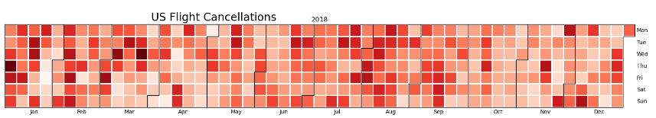
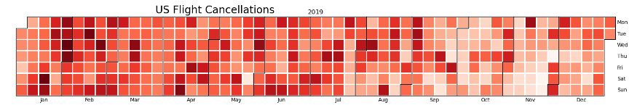
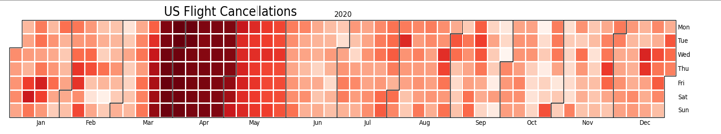
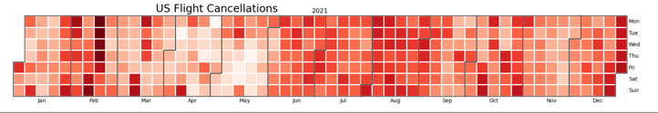
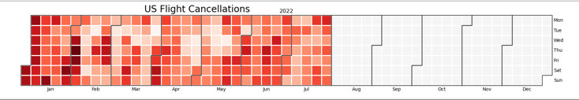
US Flight Cancellations – Heat Map
*World Health Organization declared COVID-19 a worldwide pandemic on March 11, 2020.
Source: Yale Medicine – Our Pandemic Year – A COVID-19 Timeline
Notes:
QUESTION: What are the trends in domestic flight cancellations between 2020 – 2022? What events contributed to spikes in flight cancellations? (granular view – month/daily)

Slide 9
Total Flights Cancelled (2018-2022)
Notes:
QUESTION: What are the trends in domestic flight cancellations between 2020 – 2022? What events contributed to spikes in flight cancellations? (macro view – annual)
2018: 1.6% of all flights
2019: 1.9% of all flights
2020: 5.99% of all flights
2021: 1.76% of all flights
2022: 3.02% of all flights (through July)

Slide 10
Flight Cancellation Reasoning
The primary reason more flights were canceled in 2020 compared to 2021 is the onset of the COVID-19 pandemic.
As 2021 progressed, vaccination efforts began, and countries implemented measures to control the spread of the virus.
Many airlines adjusted their operations, implemented safety protocols, and adapted to the evolving circumstances.
The demand for air travel gradually increased, and the need for widespread flight cancellations diminished in comparison to the more severe disruptions experienced in 2020.
Notes:
The world experienced widespread lockdowns, travel restrictions, and a significant decrease in passenger demand due to the rapid spread of the virus.
These factors led to a sharp decline in air travel, causing airlines to cancel flights in response to reduced demand, financial challenges, and logistical difficulties.
Although the aviation industry continued to face challenges, the situation generally improved compared to the previous year.

Slide 11
Did the pandemic impact the frequency or duration of flight delays?
Question 3.

Slide 12
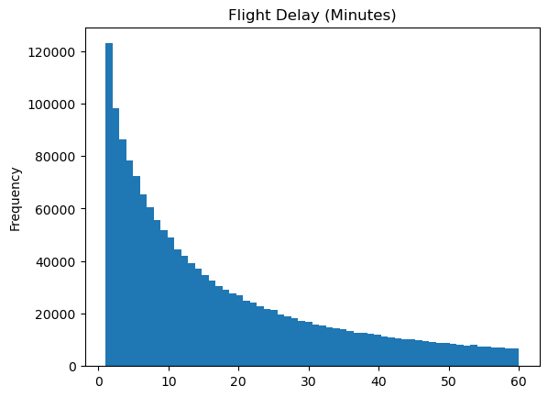
2018 Flight Delays (Total Minutes)
Represents the distribution of flight delays (in minutes) for flights where the departure delay is greater than 0 minutes and less than 61 minutes.
Notes:
QUESTION: Did the pandemic impact the frequency or duration of flight delays?
X-Axis (Horizontal): Represents the range of delay minutes. It's divided into bins, and each bin covers a specific range of delay minutes.
Y-Axis (Vertical): Represents the frequency or count of flights falling into each bin.
Bins: The data is divided into 60 bins (specified by bins=60), each covering a one-minute interval. So, each bar in the histogram represents the count of flights with a delay falling within a one-minute range.

Slide 13

2019 Flight Delays (Total Minutes)
Represents the distribution of flight delays (in minutes) for flights where the departure delay is greater than 0 minutes and less than 61 minutes.
Notes:
QUESTION: Did the pandemic impact the frequency or duration of flight delays?
X-Axis (Horizontal): Represents the range of delay minutes. It's divided into bins, and each bin covers a specific range of delay minutes.
Y-Axis (Vertical): Represents the frequency or count of flights falling into each bin.
Bins: The data is divided into 60 bins (specified by bins=60), each covering a one-minute interval. So, each bar in the histogram represents the count of flights with a delay falling within a one-minute range.

Slide 14
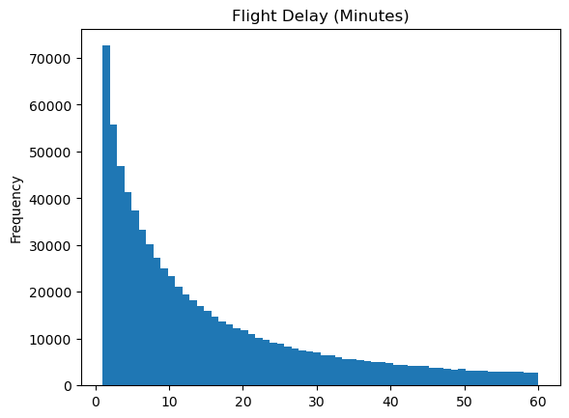
2020 Flight Delays (Total Minutes)
Represents the distribution of flight delays (in minutes) for flights where the departure delay is greater than 0 minutes and less than 61 minutes.
Notes:
QUESTION: Did the pandemic impact the frequency or duration of flight delays?
X-Axis (Horizontal): Represents the range of delay minutes. It's divided into bins, and each bin covers a specific range of delay minutes.
Y-Axis (Vertical): Represents the frequency or count of flights falling into each bin.
Bins: The data is divided into 60 bins (specified by bins=60), each covering a one-minute interval. So, each bar in the histogram represents the count of flights with a delay falling within a one-minute range.

Slide 15

2021 Flight Delays (Total Minutes)
Represents the distribution of flight delays (in minutes) for flights where the departure delay is greater than 0 minutes and less than 61 minutes.
Notes:
QUESTION: Did the pandemic impact the frequency or duration of flight delays?
X-Axis (Horizontal): Represents the range of delay minutes. It's divided into bins, and each bin covers a specific range of delay minutes.
Y-Axis (Vertical): Represents the frequency or count of flights falling into each bin.
Bins: The data is divided into 60 bins (specified by bins=60), each covering a one-minute interval. So, each bar in the histogram represents the count of flights with a delay falling within a one-minute range.

Slide 16
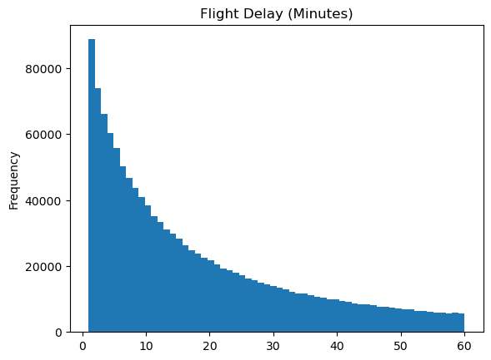
2022 Flight Delays (Total Minutes)
Data is through July.
Represents the distribution of flight delays (in minutes) for flights where the departure delay is greater than 0 minutes and less than 61 minutes.
Notes:
QUESTION: Did the pandemic impact the frequency or duration of flight delays?
X-Axis (Horizontal): Represents the range of delay minutes. It's divided into bins, and each bin covers a specific range of delay minutes.
Y-Axis (Vertical): Represents the frequency or count of flights falling into each bin.
Bins: The data is divided into 60 bins (specified by bins=60), each covering a one-minute interval. So, each bar in the histogram represents the count of flights with a delay falling within a one-minute range.

Slide 17
Domestic Flight Delay Groups (2018-2022)
Notes:
QUESTION: Did the pandemic impact the frequency or duration of flight delays?

Slide 18
2018 Delay Groups by Month
2019 Delay Groups by Month
Delay Group | On Time Early | Small Delay | Medium_Delay | Large_Delay | Cancelled
Month
1 | 65.0% | 15.2% | 9.1% | 8.0% | 2.8%
2 | 60.5% | 18.4% | 11.1% | 8.1% | 1.9%
3 | 62.0% | 18.2% | 10.1% | 7.1% | 2.6%
4 | 65.8% | 16.4% | 9.2% | 7.6% | 1.0%
5 | 60.5% | 18.0% | 10.7% | 9.6% | 1.2%
6 | 57.1% | 19.1% | 11.5% | 10.8% | 1.4%
7 | 58.5% | 18.1% | 11.1% | 10.7% | 1.7%
8 | 59.2% | 16.5% | 10.4% | 11.6% | 2.3%
9 | 70.2% | 13.5% | 7.6% | 7.1% | 1.5%
10 | 69.2% | 15.3% | 8.2% | 6.5% | 0.78%
11 | 64.9% | 16.7% | 9.4% | 7.8% | 1.2%
12 | 65.1% | 16.6% | 9.5% | 7.6% | 1.2%
Delay Group | On Time Early | Small Delay | Medium Delay | Large Delay | Cancelled
Month
1 | 65.5% | 14.9% | 8.6% | 7.9% | 3.1%
2 | 60.1% | 16.3% | 10.4% | 10.0% | 3.1%
3 | 65.7% | 16.1% | 8.7% | 7.5% | 2.0%
4 | 65.9% | 14.8% | 8.5% | 8.5% | 2.4%
5 | 63.3% | 15.9% | 9.4% | 9.4% | 2.0%
6 | 58.1% | 17.1% | 10.9% | 11.8% | 2.1%
7 | 62.1% | 16.0% | 9.5% | 10.4% | 2.1%
8 | 63.2% | 15.7% | 9.5% | 9.8% | 1.8%
9 | 71.8% | 13.4% | 6.8% | 6.3% | 1.7%
10 | 68.5% | 15.2% | 8.3% | 7.1% | 0.89%
11 | 70.3% | 15.1% | 7.7% | 6.1% | 0.85%
12 | 61.1% | 18.0% | 10.6% | 9.2% | 1.06%
Notes:
QUESTION: Did the pandemic impact the frequency or duration of flight delays?

Slide 19
2020 Delay Groups by Month
2021 Delay Groups by Month
Delay Group | On Time Early | Small_Delay | Medium_Delay | Large_Delay | Cancelled
Month
1 | 71.3% | 14.2% | 7.3% | 5.9% | 1.3%
2 | 71.4% | 13.6% | 7.2% | 6.8% | 1.0%
3 | 67.8% | 7.8% | 4.2% | 3.4% | 16.9%
4 | 52.9% | 3.0% | 1.4% | 1.3% | 41.3%
5 | 82.5% | 6.7% | 2.5% | 1.9% | 6.4%
6 | 83.8% | 9.6% | 3.6% | 2.5% | 0.43%
7 | 83.8% | 8.3% | 3.8% | 3.3% | 0.79%
8 | 84.3% | 8.2% | 3.6% | 2.8% | 1.1%
9 | 85.3% | 8.4% | 3.2% | 2.4% | 0.73%
10 | 83.4% | 9.3% | 3.8% | 2.9% | 0.53%
11 | 85.2% | 8.3% | 3.4% | 2.6% | 0.54%
12 | 77.8% | 11.7% | 5.5% | 3.8% | 1.07%
Delay Group | On Time Early | Small Delay | Medium Delay | Large_Delay | Cancelled
Month
1 | 81.6% | 9.2% | 4.4% | 3.7% | 1.1%
2 | 72.0% | 11.5% | 5.8% | 5.0% | 5.8%
3 | 76.6% | 12.6% | 5.6% | 3.9% | 1.3%
4 | 76.0% | 13.4% | 5.8% | 4.2% | 0.54%
5 | 70.7% | 15.9% | 7.3% | 5.7% | 0.45%
6 | 57.0% | 18.5% | 11.6% | 11.4% | 1.6%
7 | 55.1% | 19.3% | 12.1% | 11.8% | 1.7%
8 | 57.9% | 17.5% | 11.1% | 10.4% | 3.1%
9 | 69.7% | 15.3% | 7.7% | 5.9% | 1.4%
10 | 62.5% | 17.5% | 9.9% | 8.0% | 2.1%
11 | 65.8% | 18.4% | 9.2% | 6.0% | 0.62%
12 | 57.2% | 19.1% | 11.9% | 9.5% | 2.4%
Notes:
QUESTION: Did the pandemic impact the frequency or duration of flight delays?

Slide 20
2022 Delay Groups by Month
*Data is through July 2022
Delay Group | On Time Early | Small Delay | Medium_Delay | Large_Delay | Cancelled
Month
1 | 61.1% | 14.8% | 9.2% | 8.6% | 6.3%
2 | 60.2% | 17.2% | 10.0% | 8.2% | 4.5%
3 | 59.8% | 18.4% | 11.0% | 9.2% | 1.5%
4 | 58.8% | 18.1% | 11.2% | 9.7% | 2.3%
5 | 59.2% | 18.9% | 11.0% | 8.9% | 2.0%
6 | 55.2% | 18.7% | 12.1% | 10.9% | 3.1%
7 | 57.8% | 17.7% | 11.8% | 10.9% | 1.8%
Notes:
QUESTION: Did the pandemic impact the frequency or duration of flight delays?

Slide 21
Which airlines experienced frequent delays and cancellations from 2018 – 2022?
Question 4.

Slide 22
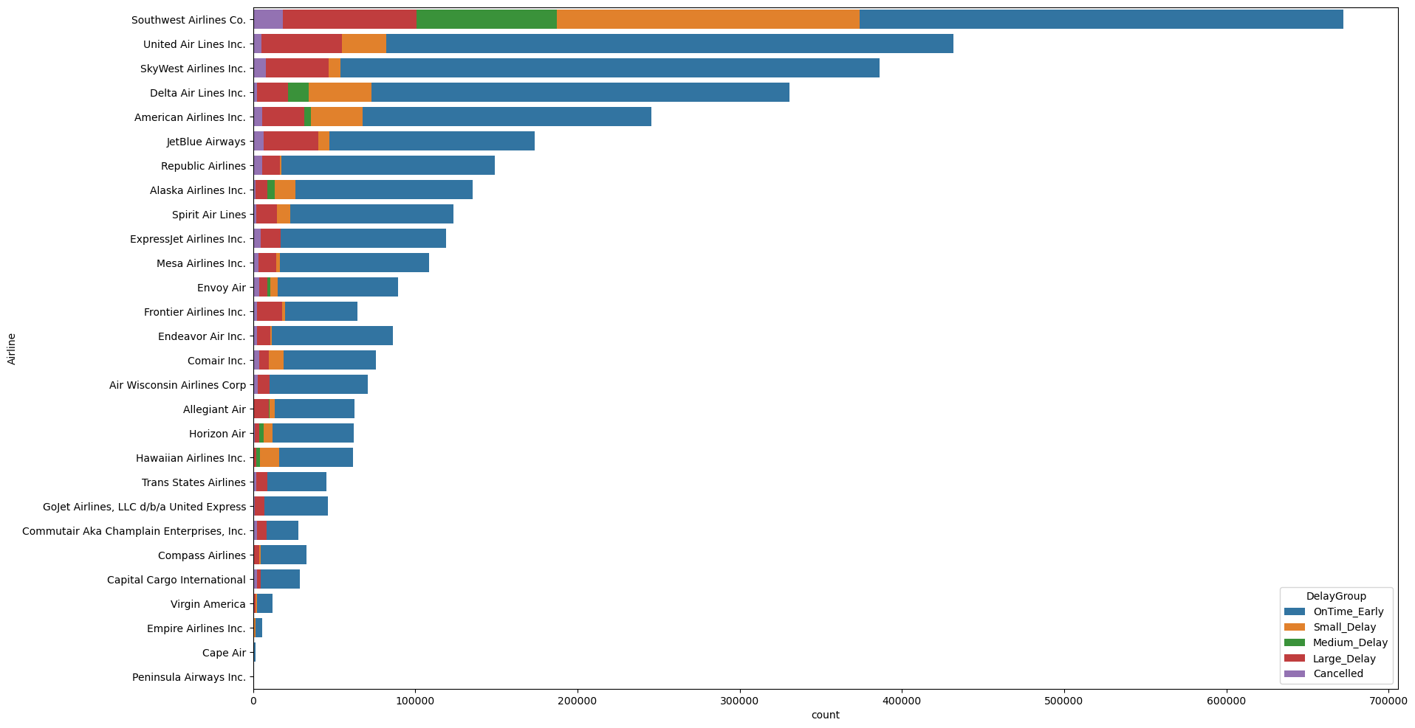
Delay Categories by Airline – 2018

Slide 23
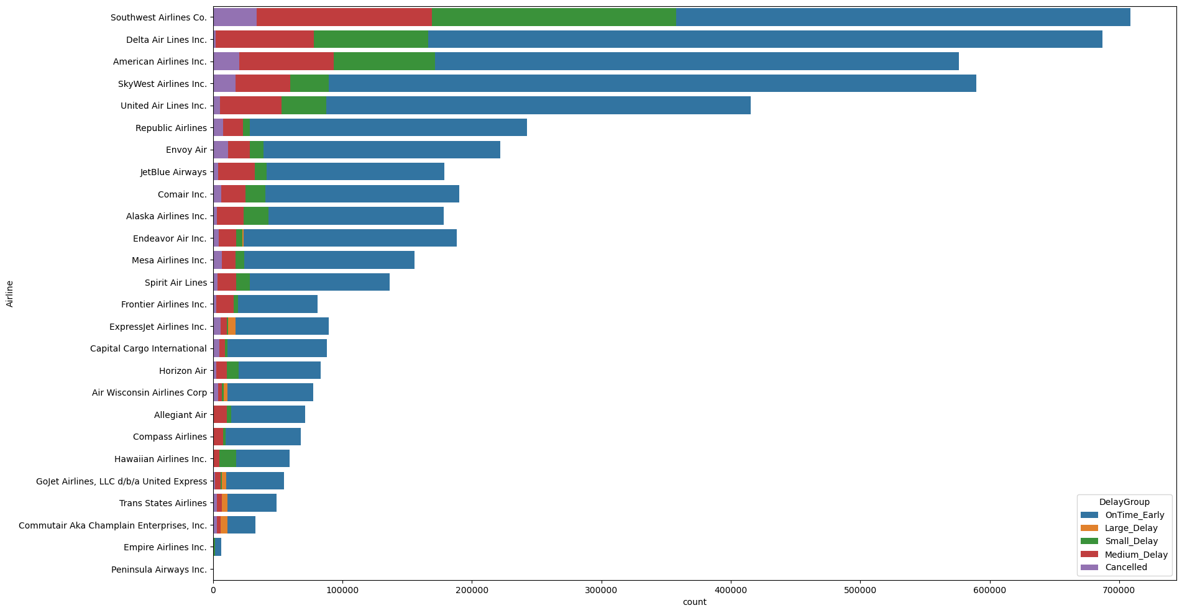
Delay Categories by Airline – 2019

Slide 24
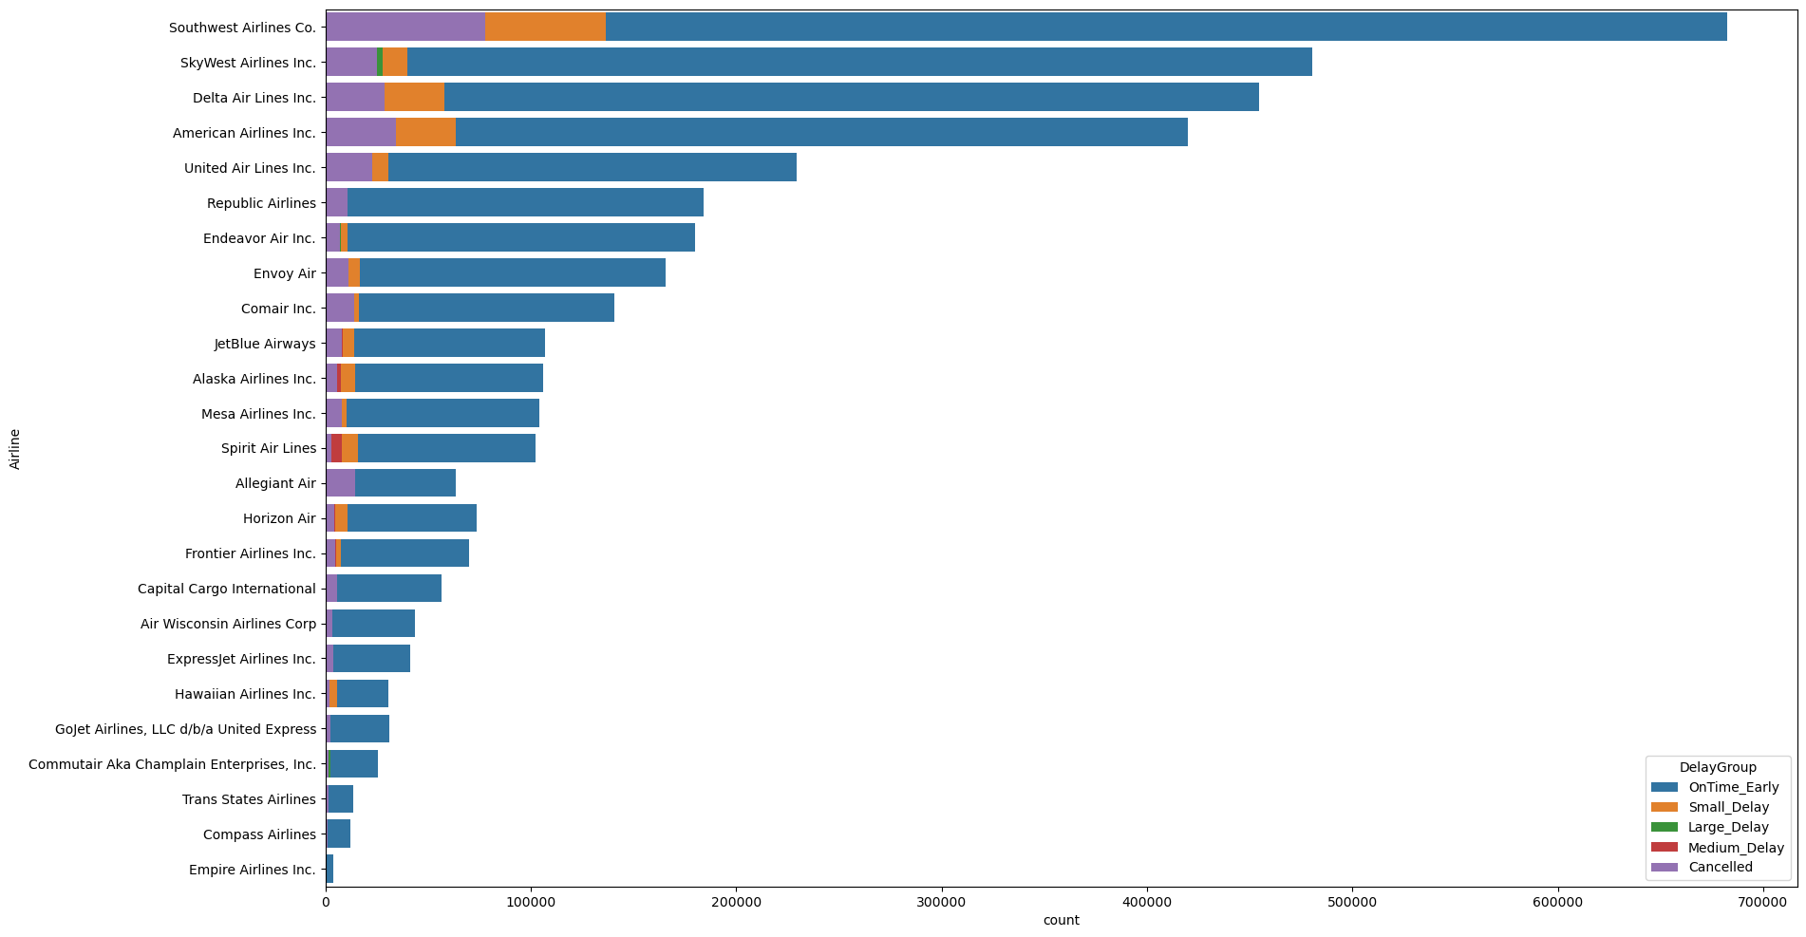
Delay Categories by Airline – 2020

Slide 25
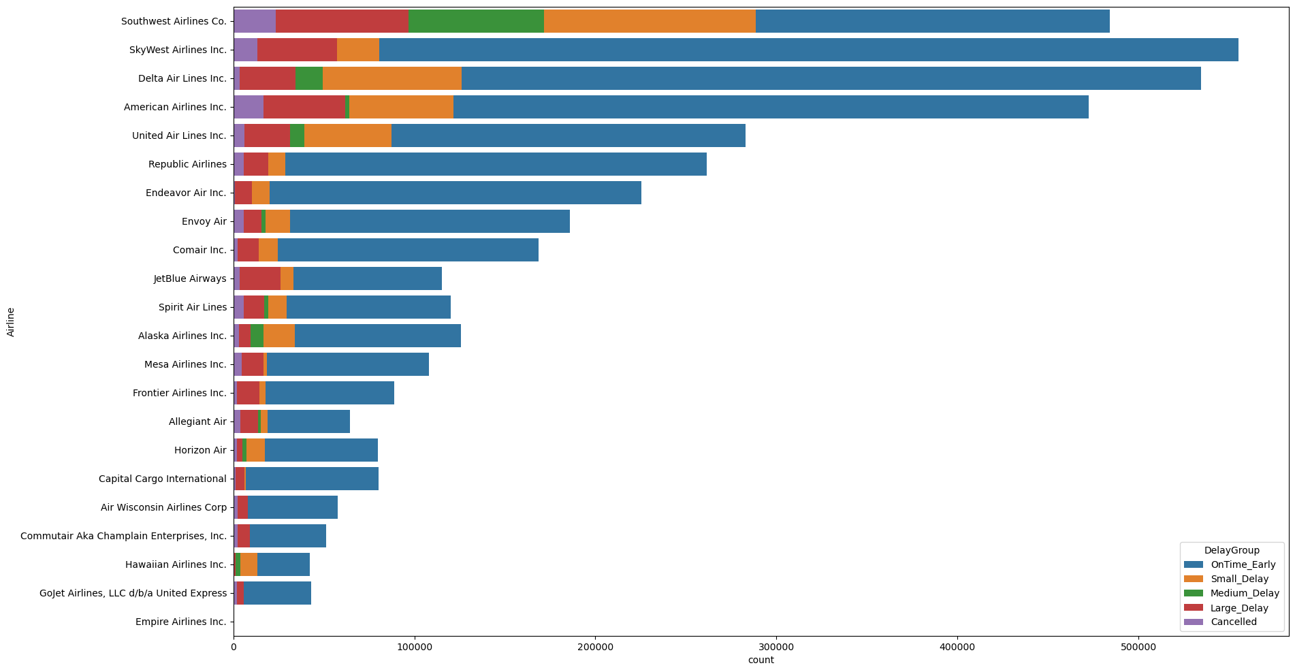
Delay Categories by Airline – 2021

Slide 26
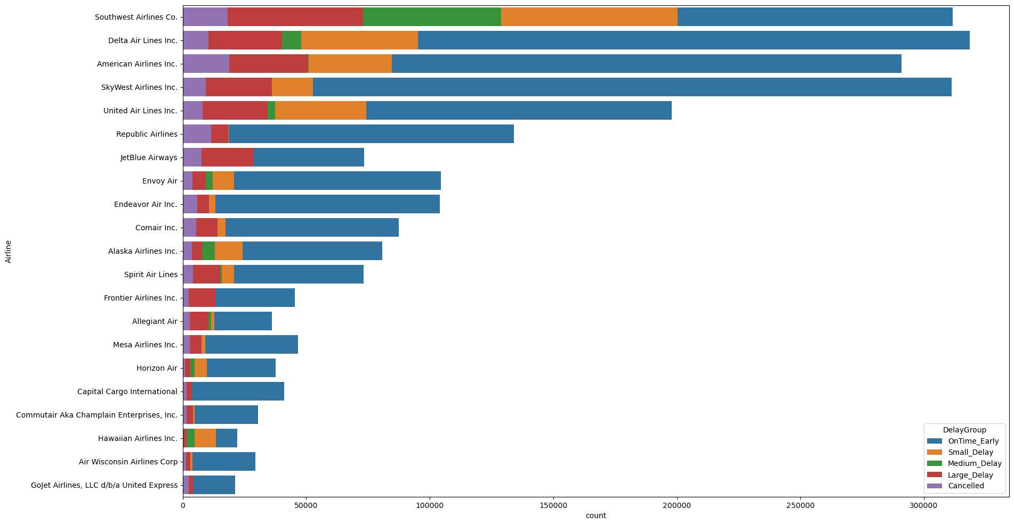
Delay Categories by Airline – 2022

Slide 27
Conclusion & Future Research
Hypothesis: The COVID-19 pandemic significantly contributed to an increase in domestic flight delays and cancellations in 2020. It is hypothesized that the widespread global health crisis led to government-imposed travel restrictions, decreased passenger demand, and operational challenges within the aviation industry, collectively resulting in a substantial disruption to domestic air travel during the specified period.
Conclusion: We conclude that our initial hypothesis is partially supported by the data. The data indicates that Covid-19 contributed to more domestic flight cancellations. However, the data doesn’t back our hypothesis that the pandemic led to more flight delays. On the contrary, with fewer people traveling during the pandemic, airlines experienced less air traffic and congestion, which likely helped reduced flight delays in 2020.
Further Research: We could incorporate geographical data and analyze changes in passenger preferences in terms of flight routes before and after the pandemic. There’s also the opportunity to study how local Covid-19 restrictions affected passenger preference and flight routes.

